Slide 1
Implementation of Heatmap
CT4009
Week 9 – Lab Worksheet

Slide 2
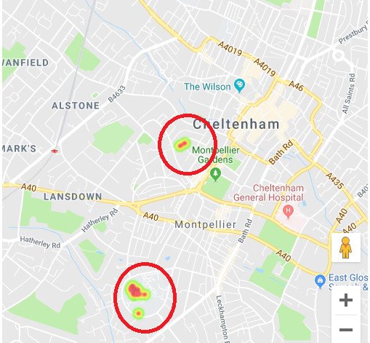
Purpose of this lab…
Implementation of Heatmap in google map based on the some location data (latitude and longitude). A database script is provided that contains data of 9 locations in Cheltenham (the first 2 are in ladies college and the last 7 are in Park Campus). The database script should be imported to MySQL database.

Slide 3
Set up your Folders…
We need 2 folders (include and HeatMap)
Include – contains the config.php file (database connection properties)
HeatMap – this folder contains the following 3 files
HeatMap.html - Show a google map
HeatMap.js - send request to php, receive location json data and display a heatmap in the google map
HeatMap.php - Read tbl_Locations_For_Heat_Map table and returns a json array to any requestor

Slide 4
First…..
Download the tbl_Locations_For_Heat_Map.sql file from moodle and import the file to create a location table (tbl_Locations_For_Heat_Map) and to populate the table with data of 9 locations in Cheltenham

Slide 5
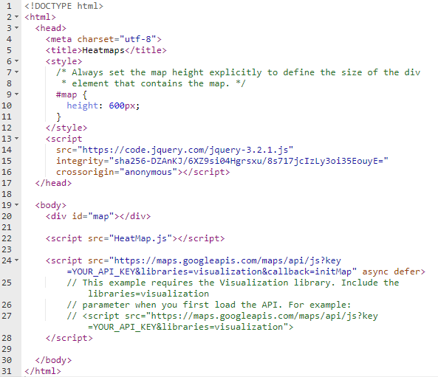
HeatMap.html
Make sure you included your google map API key here

Slide 6
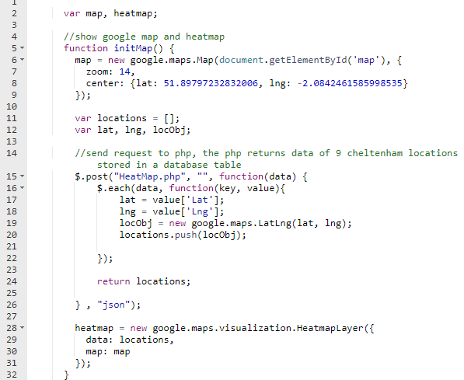
HeatMap.js

Slide 7
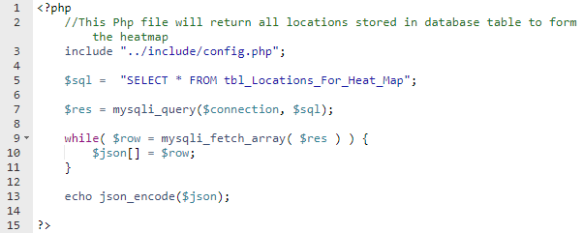
HeatMap.php
The php file returns location data stored in database table.
This returns data in json format

Slide 8
Upload files and folders
Upload all the implemented files and folder to your studentsites server (in public_html folder)
Open HeatMap.html in a browser window
You will see google map with heatmap as shown here:
Heatmap

